Slide 1
Unit 7: Sequential Logic
Presented By: Er. Ganesh Kumal

Slide 2
Contents
Event driven model and state diagram
Flip-flops and their types
Analysis of clocked sequential circuits
Decoder as memory devices
State reduction and assignment
Synchronous and asynchronous logic
Edge triggering devices
Master slave flip-flops
JK and T flip-flops

Slide 3
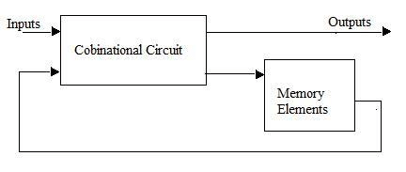
Sequential circuit
Combinational circuit with feedback element (memory).
Outputs depend upon present inputs and previous outputs (present states).
Memory elements are devices capable of storing binary information. The binary information stored in the memory elements at any given time defines the state of the sequential circuit.
Figure 6.1: Block diagram of sequential circuit.

Slide 4
Basic Flip-Flop (Latch)
Single bit storage device (memory unit).
It latches ‘0’ or ‘1’.
Basic Flip-flop circuit can be constructed from two NAND gates or two NOR gates.
The cross-coupled connection from the output of one gate to the input of the other gate constitutes a feedback path.
Each latch has two outputs ( Q and Q’ ) and two inputs Set (S) and Reset (R).
This type of flip-flop is sometimes called a direct-coupled RS flip-flop, or RS latch.

Slide 5
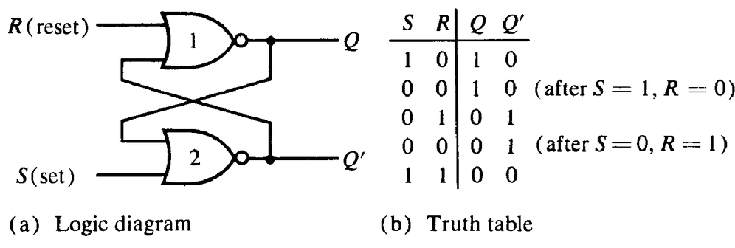
Basic Flip-Flop with NOR Gates
When,
S=0, R=0 ; No change state
S=0, R=1 ; Reset
S=1, R=0 ; Set
S=1, R=1; Invalid
Figure 6.2: NOR Latch

Slide 6
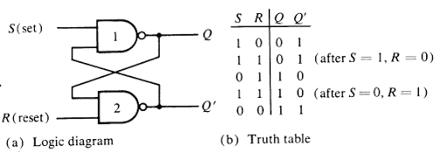
Basic Flip-Flop with NAND Gates
Figure 6.3: NAND latch

Slide 7
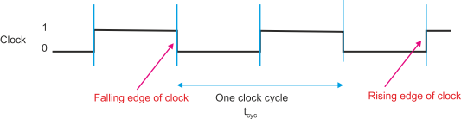
Clock Pulse
In the latches and flip-flips, we use the additional signal called clock.
Digital circuits are invariably controlled by a clock and events take place at discrete points in time.
The clock is a circuit that provides a sequence of pulses to trigger each internal operation.
Figure 6.11: Perfect idealized clock

Slide 8
Positive and Negative Edge Triggering
Depending on which portion of the clock signal the flip-flop responds to, we can classify them into two types:
Level Triggering
Positive level triggering
Negative level triggering
Edge triggering
Positive (rising) edge triggering
Negative (falling) edge triggering

Slide 9
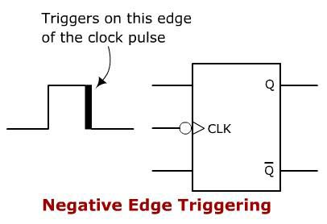
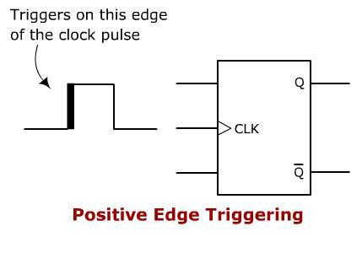
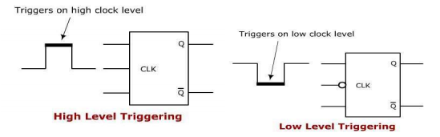
CONT…
Edge Triggering
Level Triggering

Slide 10
Flip-Flop
Sequential circuit.
Single bit memory element (storage device).
Bi-stable device (either ‘1’ or ‘0’).
Example: S-R flip-flop, D-flip-flop, J-K flip-flop, Master-Slave Flip-Flop and T-flip-flop.

Slide 11
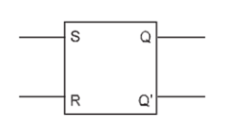
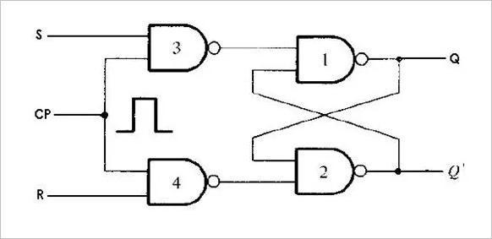
Clocked RS Flip-Flop
Inputs |  |  | Outputs
CP | S | R | Q | Q’
X | 0 | 0 | No change
1 | 0 | 1 | 0 | 1
1 | 1 | 0 | 1 | 0
1 | 1 | 1 | Invalid
CP
(a) Block diagram
(c) Truth table
(b) Logic diagram
Figure 6.4: RS Flip-Flop

Slide 12
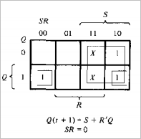
Operation of S-R flip-flop
S | R | Q(t) | Q (t +1)
0 | 0 | 0 | 0
0 | 0 | 1 | 1
0 | 1 | 0 | 0
0 | 1 | 1 | 0
1 | 0 | 0 | 1
1 | 0 | 1 | 1
1 | 1 | 0 | X (Indeterminate)
1 | 1 | 1 | X (Indeterminate)
When CP=0, flip-flop remains in previous state
When CP=1 and
S = 0, R = 0 ; flip-flop holds the data (No change).
S = 0, R = 1 ; flip-flop reset irrespective of Q
S = 1, R = 0; flip-flop set irrespective of Q .
S =1, R =1; flip-flop is invalid state
Figure: Characteristic table
Characteristic equation

Slide 13
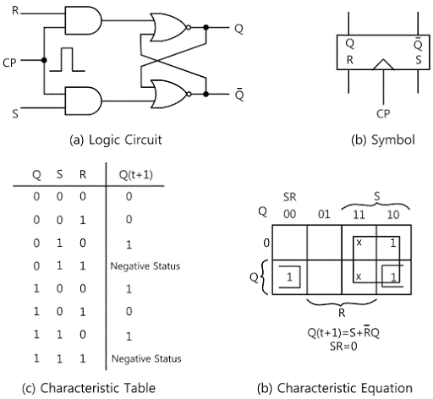
Clocked RS Flip-Flop
Indeterminate
Indeterminate
Figure 6.5: RS flip-flop by NOR latch

Slide 14
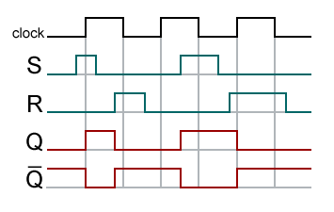
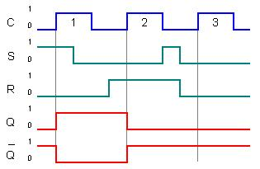
Timing diagram of S-R F/F
Figure: Level Triggering
Figure: Edge Triggering

Slide 15
D Flip-Flop
One way to eliminate the undesired condition of the indeterminate state in the RS flip-flop is to ensure that input S and R are never equal to 1 at the same time.
This is done in the D flip-flop as shown in figure 6.6.
S input is inverted and given to R input to make D flip-flop from S-R flip-flop.
Used in registers, shift registers and some of the counters.

Slide 16
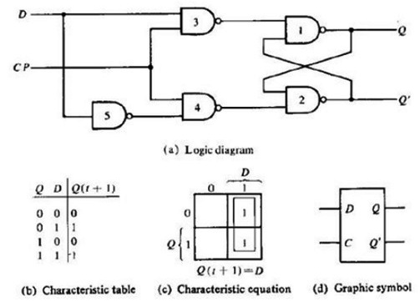
D Flip-Flop
S
Operation:
As long as CP=0, the output of gate 3 and 4 are high and the circuit cannot change the state regardless of the value of D.
When CP=1, next state of D flip-flop is always equal to data input, D.
Invalid state is removed in D flip-flop.
Advantage: Invalid state is never happened.
R
Figure 6.6: D Flip-Flop

Slide 17
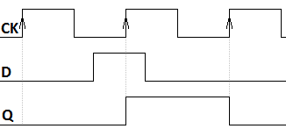
Figure: Timing diagram of D flip-flop (positive edge triggering)

Slide 18
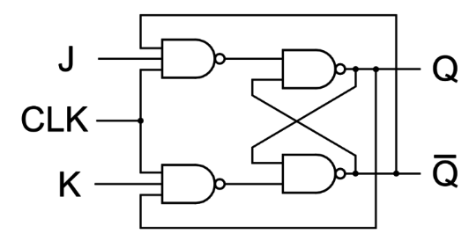
Clocked J-K Flip-Flop
J-K flip-flop is a refinement of the R-S flip-flop.
The indeterminate state of the R-S flip-flop is defined in the J-K flip-flop (when S=1 and R= 1).
We consider the inputs of S-R flip-flop as S = JQ’ and R = KQ.
Inputs |  |  | Outputs
CP | J | K | Q | Q’
X | 0 | 0 | No change
1 | 0 | 1 | 0 | 1
1 | 1 | 0 | 1 | 0
1 | 1 | 1 | Toggle
CP
(a) Logic diagram
(b) Truth table
Figure 6.7: J- K Flip - Flop

Slide 19
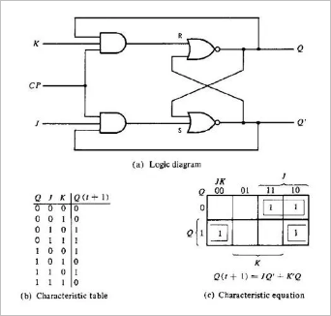
J-K Flip-Flop
Figure 6.8: J-K Flip-Flop

Slide 20
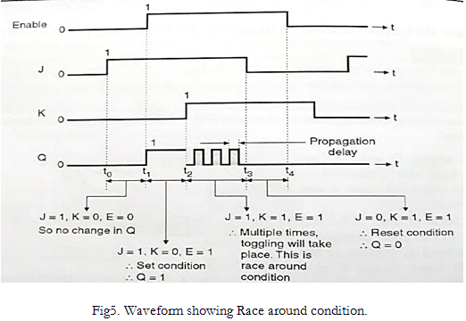
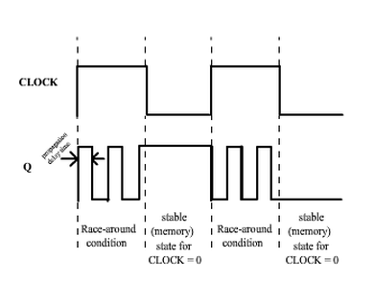
Race around condition
How to avoid race around condition??
Using Master-Slave J-K flip-flop.
Using the Edge triggering flip-flop
T/2 < propagation delay for level triggering

Slide 21
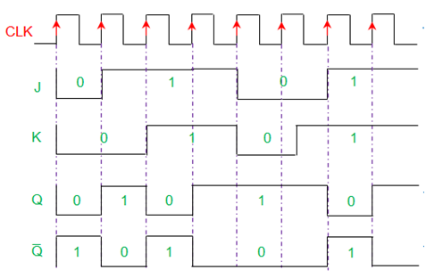
Figure: Time diagram of Edge triggered J-K flip-flop

Slide 22
J-K Master Slave F/F
Master-Slave J-K flip-flop is constructed from two separate flip-flops. One circuit serves as a master and the other as a slave and the overall circuit is referred to as a master slave flip-flop.
The master section is basically a gated latch and slave is also the same except that it is clocked an inverted clock pulse and is controlled by outputs of master section rather than by external J-K inputs.
Characteristic table is same as J-K Flip-flop.

Slide 23
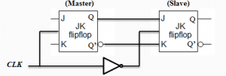
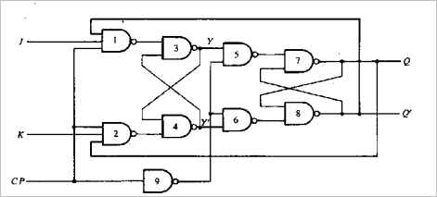
(a) Block diagram
(b) Logic diagram
Figure 6.9: Master Slave J-K flip-flop.

Slide 24
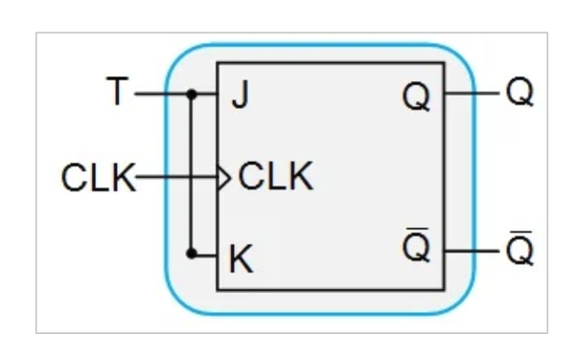
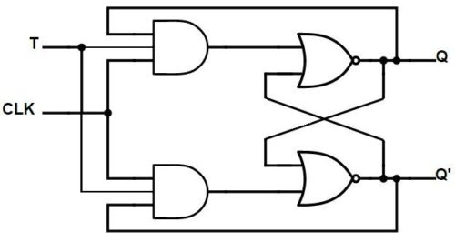
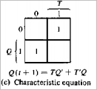
T Flip-Flop
It is obtained by connecting J and K inputs together; so only one input denoted by ‘T’.
There is only two input conditions
J = K = 1
J = K = 0
T flip-flop is used for counter.
Q(t) | T | Q(t + 1)
0 | 0 | 0
0 | 1 | 1
1 | 0 | 1
1 | 1 | 0
(a) Block diagram
K
(C) Characteristic table
J
(b) Logic diagram
Figure 6.10: T Flip-Flop

Slide 25
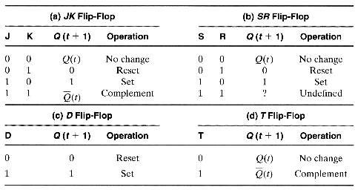
Characteristic Table

Slide 26
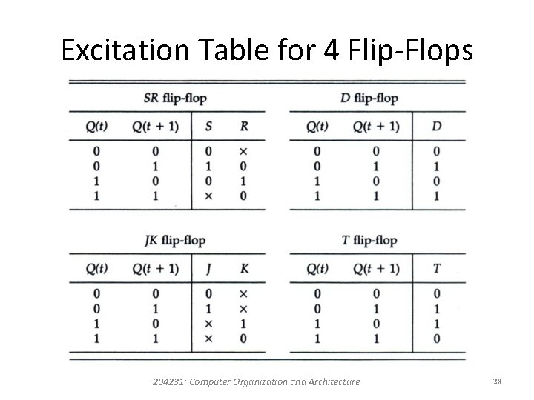
Excitation Table
A table that lists required inputs for a given change of state
( present to next state) is called an excitation table.

Slide 27
Analysis of Clocked Sequential Circuit
The behavior of a sequential circuit is determined from the inputs, the outputs, and the state of its flip-flops.
The outputs and the next state are both a function of the inputs and the present state.
The analysis of a sequential circuit consists of obtaining a table or a diagram for the time sequence of inputs, outputs, and internal states. It is also possible to write Boolean expressions that describe the behavior of the sequential circuit.
A logic diagram is recognized as a clocked sequential circuit if it includes flip-flops. The flip-flops may be of any type and the logic diagram may or may not include combinational circuit gates.

Slide 28
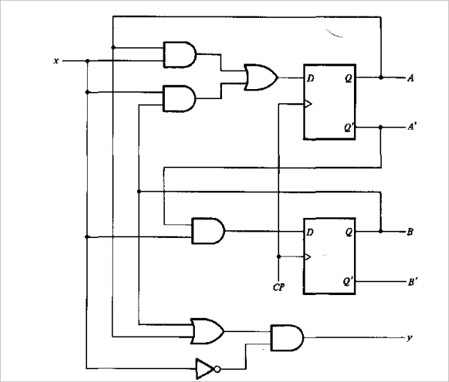
Sequential Circuit Example
State Equation
It is an algebraic expression that specifies the condition for a flip-flop state transition.
The circuit consists of two D flip-flops A and B, an input x, and an output y.
Since the D inputs determine the flip-flops' next state, it is possible to write a set of next-state equations for the circuit: A(t + I) = A(t)x(t) + B(t)x(t) B(t + I) = A '(t)x(t)
The previous equations can be expressed in more compact form as follows: A(t + I) = Ax + Bx B(t + I) = A'x
Figure 6.17: Sequential circuit example

Slide 29
Similarly, the present-state value of the output can be expressed algebraically as follows: y(t) = [A(t) + B(t)]x'(t) Removing the symbol (t) for the present state. we obtain the output Boolean function: y = (A + B)x‘
State Table
The time sequence of inputs, outputs, and flip-flop states (present state and next state) can be enumerated in a state table.
The table consists of four sections:
Present state: Shows the states of flip-flops A and B at any given time t.
Input: Gives a value of X for each possible present state.
Output: Gives the value of Y for each present state
Next state: Shows the state of flip-flops after one clock pulse

Slide 30
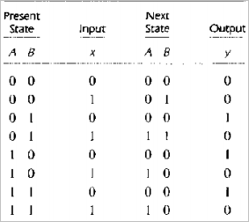
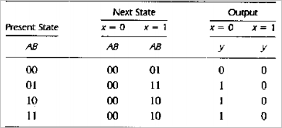
Next state and output column is derived from the state equations.
State table for the circuit of figure 6-17
A(t + I) = AX + BX B(t + I) = A‘X
y = (A + B)X‘
Second form of the state table

Slide 31
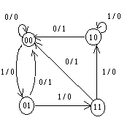
State Diagram
The information available in a state table can be represented graphically in a state diagram(or vice-versa).
state diagram is a pictorial representation of the relationship between present state, input, next state and output of sequential circuit.
In this type of diagram, a state is represented by a circle, and the transition between states is indicated by directed lines connecting the circles.
Figure: State diagram of circuit of figure 6.17

Slide 32
State Reduction and Assignment
State Reduction
Reduction on the number of flip-flops and the number of gates.
Reduction in the number of states may result in a reduction in the number of flip-flops.
State-reduction algorithms are concerned with procedures for reducing the number of states in a state-table while keeping the external input-output requirements unchanged.

Slide 33
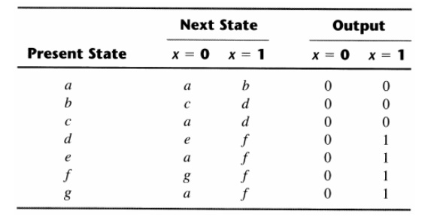
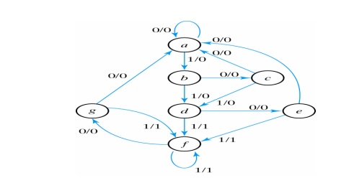
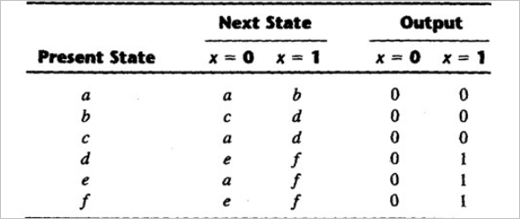
Example:
State table from the state diagram
Same next state and same output at e and g state, so e= g and state g is reduction.
Figure: State diagram
Equivalent state
Two states are said to be equivalent
For each member of the set of inputs, they give exactly the same output and send the circuit to the same state.
One of them can be removed

Slide 34
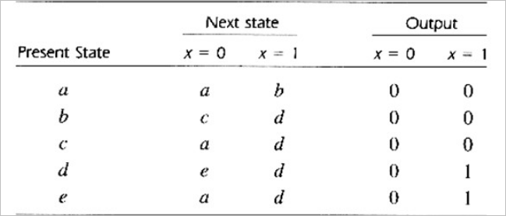
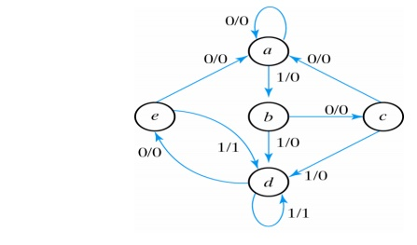
Reduced state table
State assignment:
a = 000
b = 001
c = 010
d = 011
e = 100
Figure: Reduced state diagram

Slide 35
Characteristic Table

Slide 36
Excitation Table
A table that lists required inputs for a given change of state
( present to next state) is called an excitation table.

Slide 37
Design Procedure
From the given information ( state diagram or word description of the circuit behavior) obtain the state table.
The number of states can be reduced by state reduction method.
Assign binary values to each state.
Determine the no. of flip-flops needed and assign a letter symbol to each.
Choose type of flip-flop to be used
From the state table, derive the circuit excitation and output table.
Derive the output functions and input functions using K-map.
Draw the logic diagram.

Slide 38
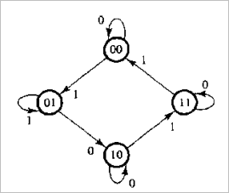
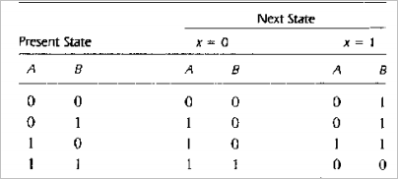
Example: Design synchronous sequential circuit for the given state diagram using J-K F/F
The state diagram consists of four states with binary values already assigned.
Directed lines contain single binary digit without a slash, so no output variables.
The two flip-flops needed to represent the four states are designated A and B.
The input variable is designated X.
Figure: State diagram for design example
The state table for this circuit, derived from the state diagram. Note that there is no output section for this circuit
Table: State table

Slide 39
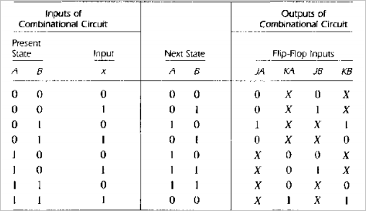
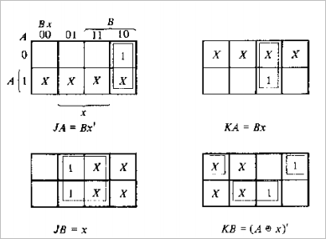
Table
Excitation table
Figure: Maps for combinational circuit
Since J-K flip-flops are used we need columns for the J and K inputs of flip-flops A ( denoted by JA and KA) and B (denoted by JB and KB).

Slide 40
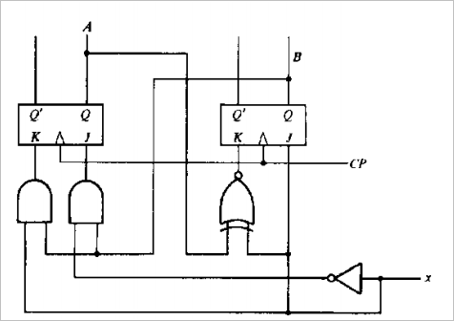
Figure: Logic diagram of sequential circuit

Slide 41
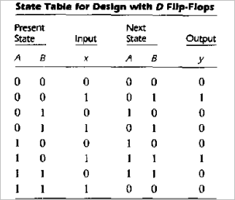
Example: Design sequential circuit with D flip-flops having following next states and output columns.
DA (A, B, X) = Σ m (2, 4, 5, 6)
DB (A, B, X) = Σ m (1, 3, 5, 6)
Y (A, B, X) = Σ m (1, 5)
Figure: state diagram
From the K-map simplification
DA = AB’ + BX’
DB = A’X + B’X + ABX’
Y = B’X

Slide 42
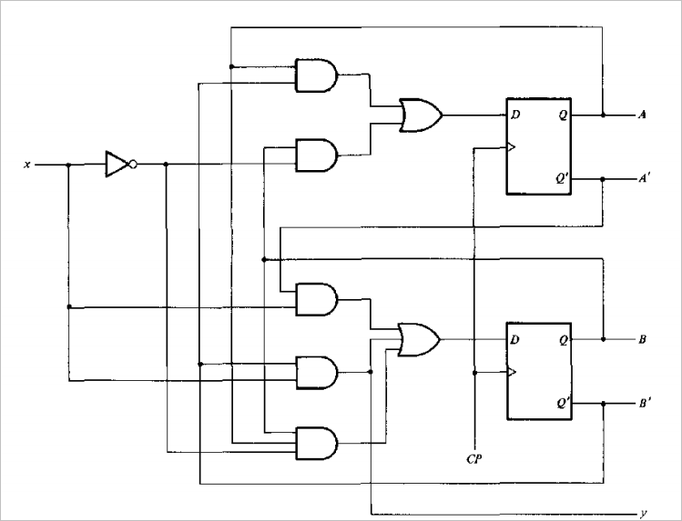
DA = AB’ + BX’
DB = A’X + B’X + ABX’
Y = B’X
Figure: Logic diagram of sequential circuit with D flip-flop

Slide 43
Design Counter
A sequential circuit that goes through a prescribed sequence of states upon the application of input pulses is called a counter.
In a counter, the sequence of states may follow a binary count or any other sequence of states.
A counter that follows the binary sequence is called a binary counter.
An n-bit binary counter consists of n flip-flops and can count in binary from 0 to 2n - 1.

Slide 44
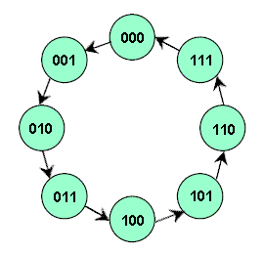
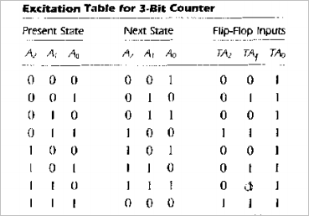
Design 3-bit counter
Figure: State diagram

Slide 45
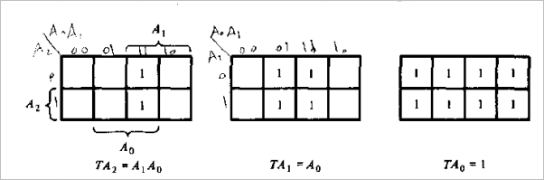
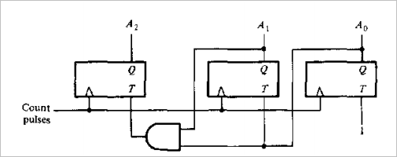
Maps for 3-bit binary counter
Figure: Logic diagram for 3-bit binary counter

Slide 46
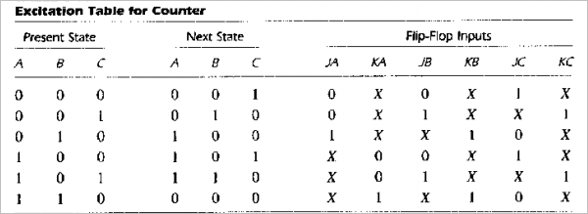
Counter with Non-binary Sequence
Design a counter as shown in state diagram below.
000
001
110
010
101
100
Figure: State diagram

Slide 47
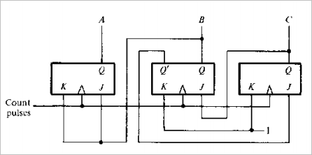
Inputs KB and KC have only I's and X's in their columns, so these inputs are always equal to I. The other flip-flop input functions can be simplified using min-terms 3 and 7 as don't-care conditions. The simplified functions are:
JA = B KA = B
JB = C KB = 1
JC = B’ KC = 1
You have to show the K-map for simplification
Figure: Logic diagram of counter

